Slide 1
Supporting Young People Training
Hereford and Worcester
Notes:
Put links to appropriate support documents on scoutshw

Slide 2
Supporting Young People (14)
  Who is this training for?
This training is part of the Wood Badge for:
Section Leaders
Assistant Section Leaders
It may also be helpful for Section Assistants
Adults who completed their Wood Badge many years ago may wish to update their knowledge in this area and will find this training helpful.

Slide 3
Supporting Young People
  Aim
To enable adult volunteers working with young people to understand and meet their needs.
  Objectives
List typical characteristics of young people in your section
Recognise ways in which young people develop as they move through Scouting
Outline how young people’s relationships with their peers and adults typically changes during their development
Recognise the influences of culture and society in young people’s lives
Create a supportive environment for young people, to promote physical and emotional wellbeing and facilitate development.
Demonstrate good practice in communicating with young people in your section.
Recognise issues that may affect young people and identify sources of support.

Slide 4
Supporting Young People (14)
Session 1 – Characteristics and Development
Objectives:
List typical characteristics of young people in your section.
Recognise ways in which young people develop as they move through Scouting.

Slide 5
  TASK ONE – 5 mins
      In Breakout rooms – by Section.
      Draw a picture (you can do one each or you can delegate somebody to do this) annotated with typical characteristics of a young person in your Section. Be prepared to feed back,

Slide 6
  KEY MESSAGE ONE
      Scouting is designed to meet the changing needs, characteristics and interests of young people.

Slide 7
Puberty?
Volunteers in which sections need to have an awareness of puberty?

Slide 8
Adolescence Quiz
1 - What is puberty?
A stage in life, starting for girls when they begin their period and boys when their voice starts breaking.
The stage in life where sex hormones are released, the body matures sexually and the reproductive organs become functional.
A transitional process between childhood and adulthood.

Slide 9
Adolescence Quiz
2 - What is the average age that young people start puberty?
Girls 9 years, boys 13 years
Girls 10 years, boys 9 years
Girls 11 years, boys 12 years

Slide 10
Adolescence Quiz
3 – Between what ages do girls usually start puberty?
10 – 14 years
8 – 14 years
12 – 15 years

Slide 11
Adolescence Quiz
4 – Between what ages do boys usually start puberty?
9 – 14 years
10 – 14 years
12 – 15 years

Slide 12
Adolescence Quiz
5 – The age that girls start puberty has…
Increased
Decreased
Remained constant

Slide 13
Adolescence Quiz
6 – How long does puberty last?
It varies
Around 5 years
2 – 3 years

Slide 14
Adolescence Quiz
7 – Mood swings in puberty are:
A result of bad parenting
A natural result of the hormonal changes in puberty
Due to a lack of understanding of puberty

Slide 15
Adolescence Quiz
8 – What changes take place in adolescence?
Physical
Psychological
Behavioural
All of the above

Slide 16
Adolescence Quiz
9 – The brain of a young person in adolescence has similarities to the brain of…
An adult
A toddler
A 6 year old.

Slide 17
Adolescence Quiz
10 – Which of the following are part of changes in the brain in adolescence?
Difficulty understanding others’ perspective
Low mood and depression
Mood swings
Reduced capacity for empathy
Increased capacity for emphathy
Difficulties with self discipline / control
High energy levels
Increased tendency for risk-taking

Slide 18
  KEY MESSAGE TWO
      Each young person is different, but there are common stages of development.

Slide 19
Supporting Young People (14)
Session 2 – External Influences
Objectives:
Outline how young peoples’ relationships with their peers and adults typically change during their development.
Recognise the influence of culture and society in young people’s lives.

Slide 20
  KEY MESSAGE THREE
      Young people experience many external pressures and anxieties. Your experiences could be very different to what young people experience today.

Slide 21
  KEY MESSAGE FOUR
      We are living in a diverse and multi-cultural society. It is important to be aware of the family circumstances of the young person.

Slide 22
  KEY MESSAGE FIVE
      Adults have a key role to play in supporting and helping prepare young people as they transition between sections.

Slide 23




  TASK TWO
LOW
INFLUENCE
HIGH
INFLUENCE
PARENTS / CARERS
FRIENDS / PEERS
OLDER YOUNG PEOPLE
LEADERS / VOLUNTEERS IN SCOUTING
CELEBRITIES

Slide 24
  KEY MESSAGE SIX
      As an adult volunteer in Scouting, you are an influential role model for young people.

Slide 25
  KEY MESSAGE SEVEN
      There must be some consistency in adults’ behaviour with young people, regardless of age.

Slide 26
Relationships?
Discuss the scenario – how would you respond if…
A young leader tells you that she slept with one of the other Explorers in their Unit without using protection.

Slide 27
Relationships?
Discuss the scenario – how would you respond if…
One of your Explorers asks you for contraception.

Slide 28
Relationships?
Discuss the scenario – how would you respond if…
One of your Cubs tells you they think they might be gay.

Slide 29
Relationships?
Discuss the scenario – how would you respond if…
You become aware that one of your Scouts is sexting someone.

Slide 30
Relationships?
Discuss the scenario – how would you respond if…
You suspect one of your Explorers might be in an abusive relationship.

Slide 31
  KEY MESSAGE EIGHT
      Young people will be developing their understanding of, and exploring, their sexuality and relationships.

Slide 32
  KEY MESSAGE NINE
      Technology, media and social media have a big influence and part in young people’s lives.

Slide 33
Discuss:
What are the opportunities of social media?
What are the risks?
Opportunities
Access to information and learning opportunities
Sources of support
Connecting with people with shared interests
Risks
Airbrushing of life – how people portray their lives on social media
Meaning of friendship – is a social media friend a real friend?
Cyber-bullying 24/7

Slide 34
Digital Lives Quiz
1 – How many hours per week do 8-11 year olds spend going online at home or elsewhere outside of school?
10.5 hours
2.5 hours
15 hours

Slide 35
Digital Lives Quiz
2 – How many hours per week do 12-15 year olds spend going online at home or elsewhere outside of school?
8 hours
12 hours
17 hours

Slide 36
Digital Lives Quiz
3 – How many 15-18 years olds in the UK have met someone in person they originally met through social media
A third
5%
A half

Slide 37
Digital Lives Quiz
4 – What age are Moshi Monsters and Club Penguins particularly designed for?
8 – 12 years
10 – 16 years
6 – 14 years
These are multiplayer online games and contain virtual elements.

Slide 38
Digital Lives Quiz
5 – What percentage of 15-18 year olds in the UK feel happier online than in real life?
10%
25%
5%

Slide 39
Digital Lives Quiz
6 – How many parents of 5-15 years olds who go online are concerned about their child giving out details to inappropriate people.
A third
90%
A quarter

Slide 40
Digital Lives Quiz
7 – At what age can young people join Facebook
16 years
13 years
10 years
The age limit for joining Facebook and many other social media such as Twitter, Instagram and Tumblr, is 13 years. However, we know that young people under the age of 13 have social media profiles and that 59% of children have already used a social network by the time they are 10. (The Social Age Study, by knowthenet.org.uk)

Slide 41
  KEY MESSAGE TWELVE
      Technology is a valuable tool, but it is important to empower young people to deal with the risks and dangers.

Slide 42
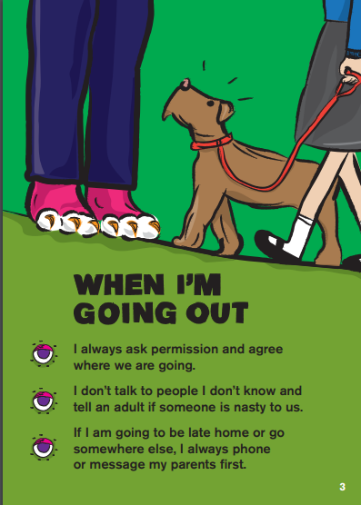




Stay Safe Leaflets

Slide 43
Supporting Young People (14)
Session 3 – Creating a supportive environment
Objectives:
Create a supportive environment for young people, to promote physical or emotional wellbeing and facilitate development
Demonstrate good practise in communicating with all young people in your section.

Slide 44
  KEY MESSAGE THIRTEEN
      Take into account young people’s basic human needs and rights.

Slide 45
  KEY MESSAGE 14
      It is important to take a proactive approach in creating a supportive and inclusive environment.

Slide 46
What do we already do… about bullying

Slide 47
  KEY MESSAGE 15
      It is important to take action to prevent bullying, and to identify and respond to any incidents effectively.

Slide 48
What do we already do?
How do our adults demonstrate the values of Scouting?
Belief
Cooperation
Integrity
Respect
Care

Slide 49
  KEY MESSAGE 16
      Adults should lead by example and demonstrate the Values of Scouting in their relationships with other adults and young people.

Slide 50
What do we already do… to build empathy and understanding?

Slide 51
  KEY MESSAGE 17
      It is important to be empathetic and put yourself in the young person’s shoes.

Slide 52
  TASK THREE – 3 mins
      Reflect on your own childhood.
      Can you think of an adult who had a significant positive influence on your life? Was it a teacher, a Scout leader or family member?
      What characteristics did this person have?
      Is there any way that you can change your practice to become more of a positive influence on the lives of the young people in your care?
      Can you make it into a short statement or motto?

Slide 53
  KEY MESSAGE 18
      Anyone working with young people has an impact and an important part to play in their mental health and wellbeing, and building resilience.

Slide 54
What do we mean by GOOD COMMUNICATION?

Slide 55
  KEY MESSAGE 19
      Adapt communication to the young people’s level of development and individual needs.

Slide 56
  KEY MESSAGE 20
      It is important to listen to young people and avoid making assumptions.

Slide 57
  KEY MESSAGE 21
      Communication is a two-way process.

Slide 58
What is mental health?
We have mental health in the same way that we have physical health, and both need to be looked after.
Good mental health is…
“The strength and capacity of our minds to grow and develop, to be able to overcome difficulties and challenges and to make the most of our abilities and opportunities.”
(Young Minds, 2008)

Slide 59
Who is responsible for young people’s mental health?
“Anyonne in contact with a child has an impact on that child’s mental health and psychological wellbeing. The challenge for all of is to remember that and to be able to respond if things start to go wrong.”
(Children and Young People in Mind; final report of the CAMHS Review, 2008)

Slide 60
Mental Health Quiz – TRUE or FALSE
1 – One in 100 children and young people aged 5-16 have a diagnosable mental health disorder.
FALSE – One in 10 children and young people between 5-16 years has a diagnosable mental health disorder.

Slide 61
Mental Health Quiz – TRUE or FALSE
2 – Research suggests that 20% of children have a mental health problem in any given year.
TRUE – Research suggests that about 20% of children have a mental health problem in any given year, and about 10% at any one time.

Slide 62
Mental Health Quiz – TRUE or FALSE
3 – Self harm is not common in young people.
FALSE – Between one in 12 and one in 15 children and young people deliberately self-harm according to a report from the Mental Health Foundation.
Self-harm describes the various things that some young people do to harm themselves in a deliberate and usually hidden way. The most common methods involve repeatedly cutting the skin. The average age of onset is 12 years old, although it can affect those who are younger.

Slide 63
Mental Health Quiz – TRUE or FALSE
4 – One in five young adults show signs of an eating disorder.
TRUE – According to Young Minds (2015).
It is important to remember that anyone can develop an eating disorder and it’s not just restricted to teenagers. Adults and younger children an be affected, and children as young as seven can develop anorexia.

Slide 64
Mental Health Quiz – TRUE or FALSE
5 – Nearly a quarter of young people fear the reaction of friends when they talk about their mental health problems.
FALSE – Nearly three in four young people fear the reactions of friends when they talk about their mental heath problems. (Time to Change campaign 2008)
Therefore it’s important to work to create supportive and open environments, where young people feel more able to talk about their feelings or to seek support. The availability of information about other sources of support, such as Childline or Samaritans can be really beneficial.

Slide 65


Slide 66
Mental Health Quiz – TRUE or FALSE
6 – Children who face three or more stressful life events, for example bereavement, divorce or serious illness, are three times more likely than other children to develop emotional and behavioural disorders..
TRUE – Scouting has an important part to play in providing a supportive environment, and supporting young people to develop their resilience and coping skills, to get through challenges in their lives.

Slide 67
Mental Health Quiz – TRUE or FALSE
7 – Young people are more vulnerable to mental health problems in adolescence.
TRUE – Young people are more vulnerable o mental health problems in times of change, and adolescence is a transitional process. Scouting can provide a valuable anchor and source of support in times of change.

Slide 68
Scouting has a positive impact on the emotional wellbeing of young people.

Slide 69
Supporting Young People (14)
Session 4 – Responding to issues affecting young people
Objectives:
Recognise issues that may affect young people and identify sources of support.

Slide 70
Discuss these scenarios
How would you respond? Where could you get support or guidance?
1 – You suspect that a young person in your section is experiencing depression

Slide 71
Discuss these scenarios
How would you respond? Where could you get support or guidance?
2 – You notice that a number of your Explorers have started smoking outside the Scout Hut before and after Explorers.

Slide 72
Discuss these scenarios
How would you respond? Where could you get support or guidance?
3 – One of your Cubs has started to become withdrawn at Scouting and has asked to change Sixes.

Slide 73
Discuss these scenarios
How would you respond? Where could you get support or guidance?
4 – You notice that one of your Scouts is extremely self critical. They refer to themselves as “stupid” and lack confidence in activities.

Slide 74
Discuss these scenarios
How would you respond? Where could you get support or guidance?
5 – One of the parents of a young person in your Beaver Colony tells you that they are separating.

Slide 75
Discuss these scenarios
How would you respond? Where could you get support or guidance?
6 – At Scouts you’ve started noticing cuts on Mason’s arms and suspect that he might be self-harming.

Slide 76
Discuss these scenarios
How would you respond? Where could you get support or guidance?
7 – One of your Cubs has experienced bereavement in the family; their younger sister has passed away from an illness.

Slide 77
Discuss these scenarios
How would you respond? Where could you get support or guidance?
8 – You are aware that the parent of one of your Scouts, Maciej, is a single parent with two children and has an illness / disability. You’ve noticed Maciej seems tired and anxious when he is at Scouts.

Slide 78

  KEY MESSAGE 21
      You don’t have to be an expert and it is important that you seek support or signpost where needed.

Slide 79
  KEY MESSAGE 22
      Life events can have a significant impact on young people.

Slide 80
  KEY MESSAGE 23
It is important to be aware of issues that can affect young people, including smoking, alcohol and substance misuse.

Slide 81
Conclusion
We’ve talked about:
Characteristics of young people
Development
Changes in external influences
Relationships
Technology and social media
Scout values and supportive environment
How we communicate
Mental health and well being
How we respond to issues

Slide 82
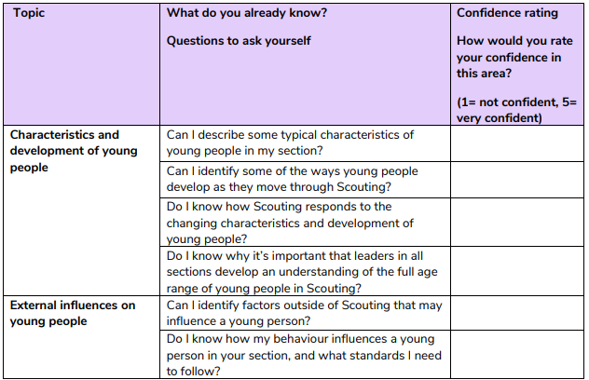
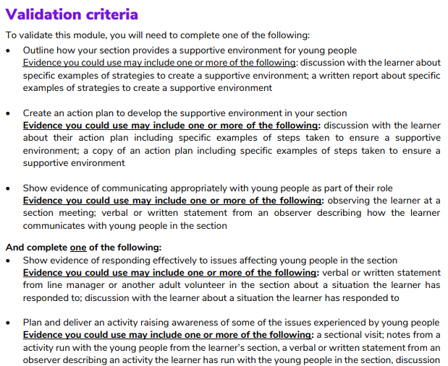
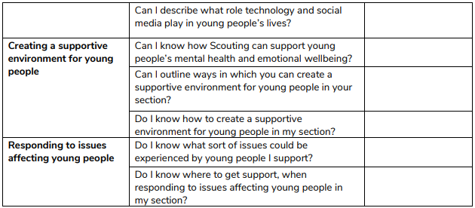
How to validate Module 14.

Slide 83
Supporting young people
  Thank you

